Slide 1
Application State Management with Redux & React-Redux

Slide 2
What is Redux? What is Flux?
Facebook’s application architecture for client-side web apps
Design pattern and library
But…Why not MVC?
Notes:
Before jumping into Redux, look at predecessor
Flux solves problem of MVC

Slide 3
MVC
Backend and frontend pattern
Bidirectional data flow
Model models data & behavior
View displays model
Controller is interface between view & model
Controllers handle all logic
Debugging difficult due to bidirectional data flow
Notes:
Before jumping into Redux, look at predecessor
Flux solves problem of MVC

Slide 4
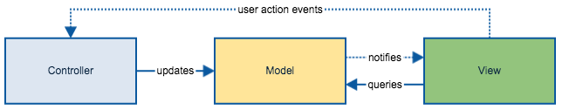
Simple MVC Example

Slide 5
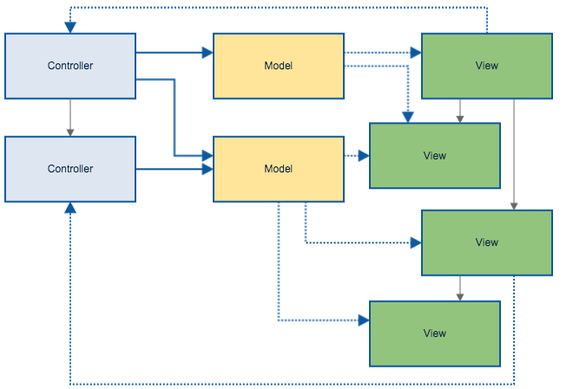
Complex MVC Example

Slide 6
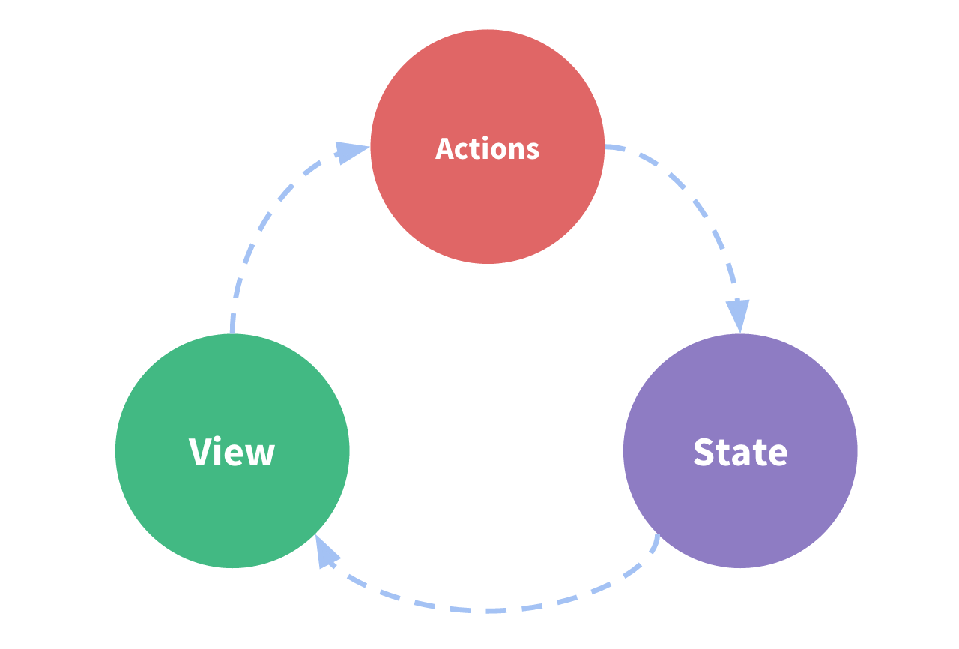
State Management, Simplified

Slide 7
Flux
Frontend pattern
Unidirectional data flow
Views display app & app state, emit Actions
Actions send data to Dispatcher
Dispatcher receives data from Actions, updates Stores
Stores contain app state and update Views
Stores handle all logic
Debugging easier due to Dispatcher

Slide 8
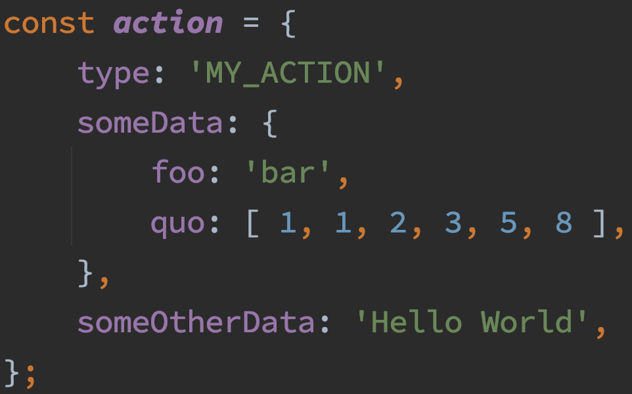
Flux Actions
Have a type
Have data

Slide 9
Flux Dispatcher
Singleton to manage data flow
Manages callbacks registered from stores
Executes callbacks in order on data updates
Data updates initiated through dispatch(payload)

Slide 10
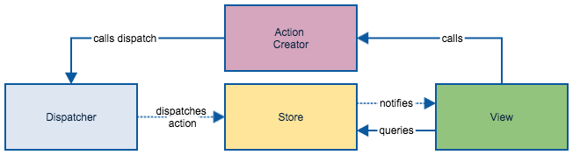
Simple Flux Example

Slide 11
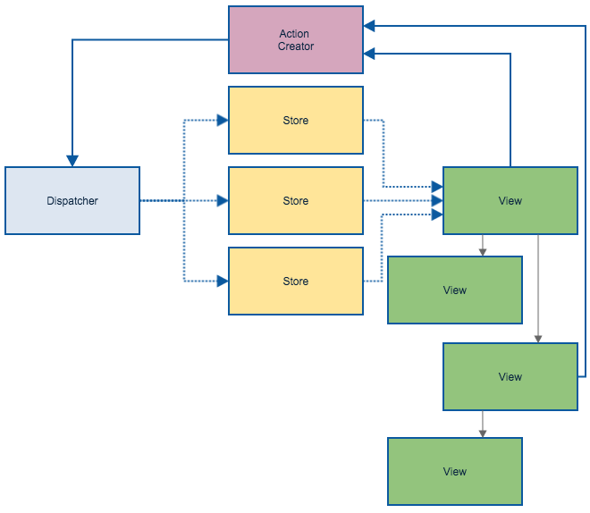
Complex Flux Example

Slide 12

Hey…umm…
I think we can do better

Slide 13
Redux
Frontend pattern
Unidirectional data flow
Views display app, emit Actions
Actions send data to Reducers
Reducers modify data, update Store
Store (singular) contains state and updates Views
Reducers handle all logic
Debugging much easier due to single store
Notes:
Reducers are pure functions

Slide 14
Redux Prerequisites
Application state must be POJOs
Changes in system must be POJOs
Logic for changes must be pure functions

Slide 15
The Power of Redux
Separates “what happened” from “how the state changes”
Bootstrap anywhere (client, server, etc.)
Trace logs
Time-travel debugging
TDD

Slide 16

Redux Example

Slide 17
